Slide 1
Trade and Inequality
Group 2
BESSON Diego
DHALIWAL Jessica
BEN MIMOUN Inès
CUI Shuhao

Slide 2
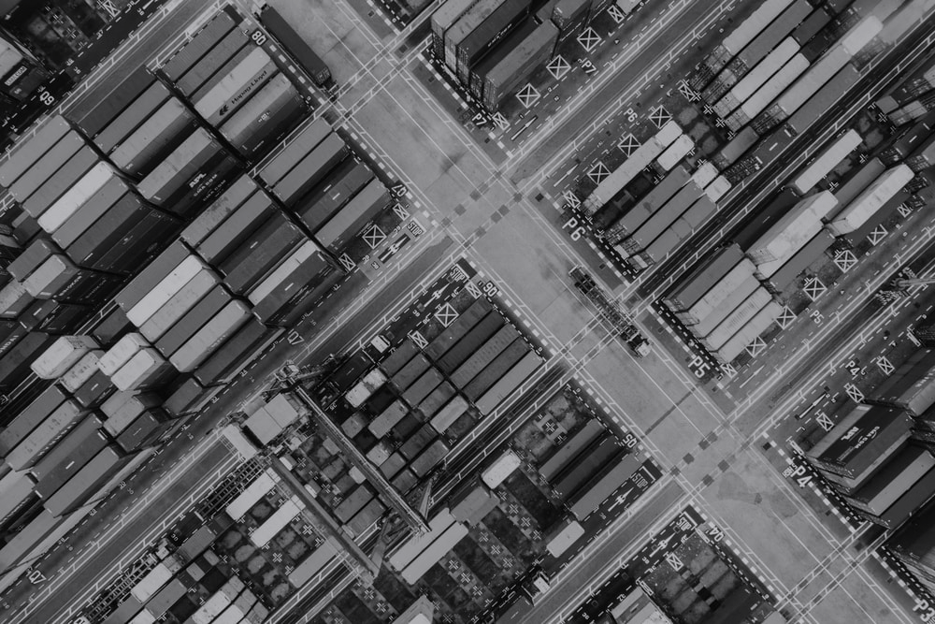
Summary
1
Introduction
2
I. Developed countries
3
II. Developing countries
4
Conclusion

Slide 3
Introduction
General constatation :
Sharp decline in the share of the top 1% of income during the first part of the 20th century,
Diverging inequalities developments in the second part of the 20th century,
Increasing inequalities within developed and developing countries during the 1980s
Pain point :
« Internalization of inequalities » ¹⁾ : The reduction of inequalities has been drastic at a global level since the 1980s but inequalities within countries have been increasing. The gap between the USA and China has been closing, but the one between rich and poors from both countries has widened.
Problematic :
Is global trade responsible for the growing inequalities within countries ?
In this presentation, we will go through the changes in developed and less developed countries to see how and to what extend the global trade affects the income inequality at a country level.
1) François BOURGUIGNON, The globalization of inequality

Slide 4
Summary
I
Focus on developed economies
A
Trends of inequalities in rich countries
B
Impact of International Trade on inequalities

Slide 5
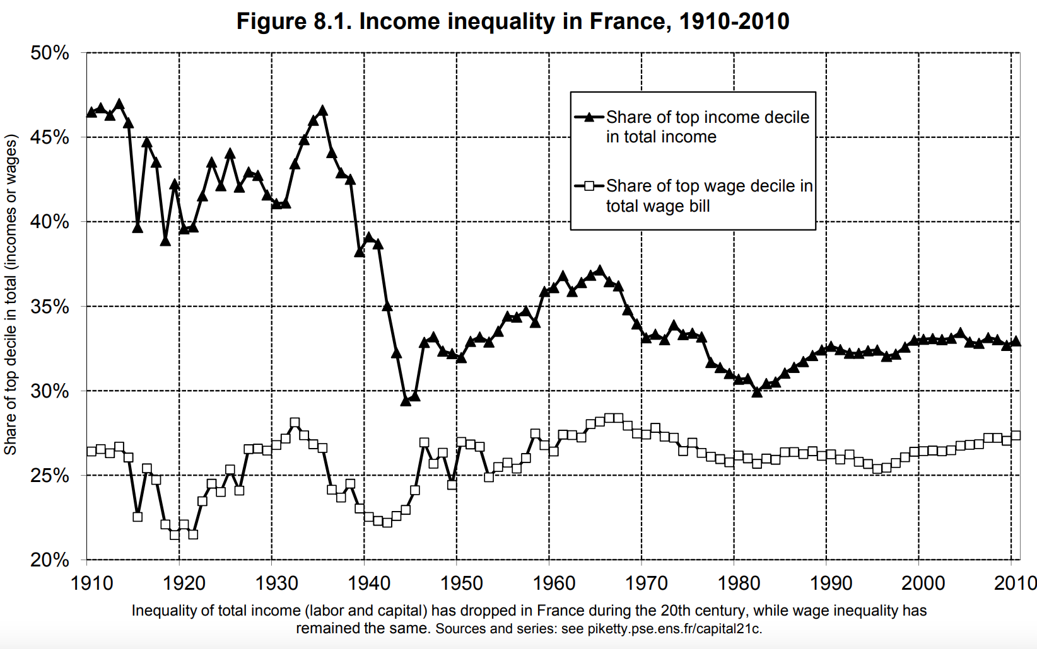
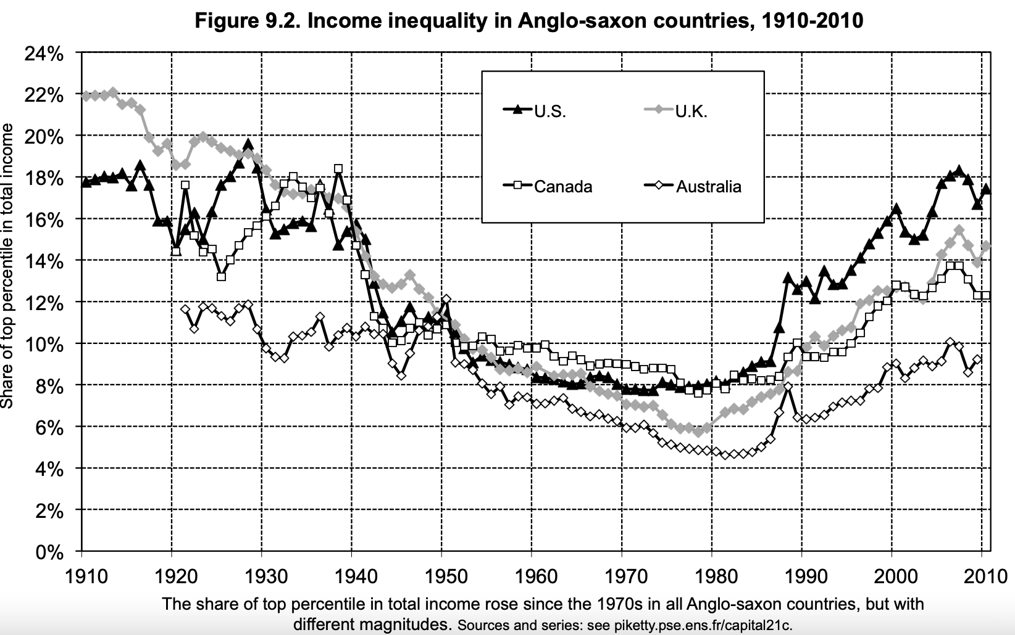
Part I : Inequality in developed countries (1/2)
Income inequalities
Drop in inequality after WWII due to a decline in the capital share of income caused by the Great Depression and the war.
Most developed countries faced a flat evolution of the top 1 % during the 1950’s to 1980’s.
Anglo-saxon countries are characterized by a significant rise in the share of the top 1 % after 1980.
Education and technologies can play
a long run role to lower these inequalities.

Slide 6
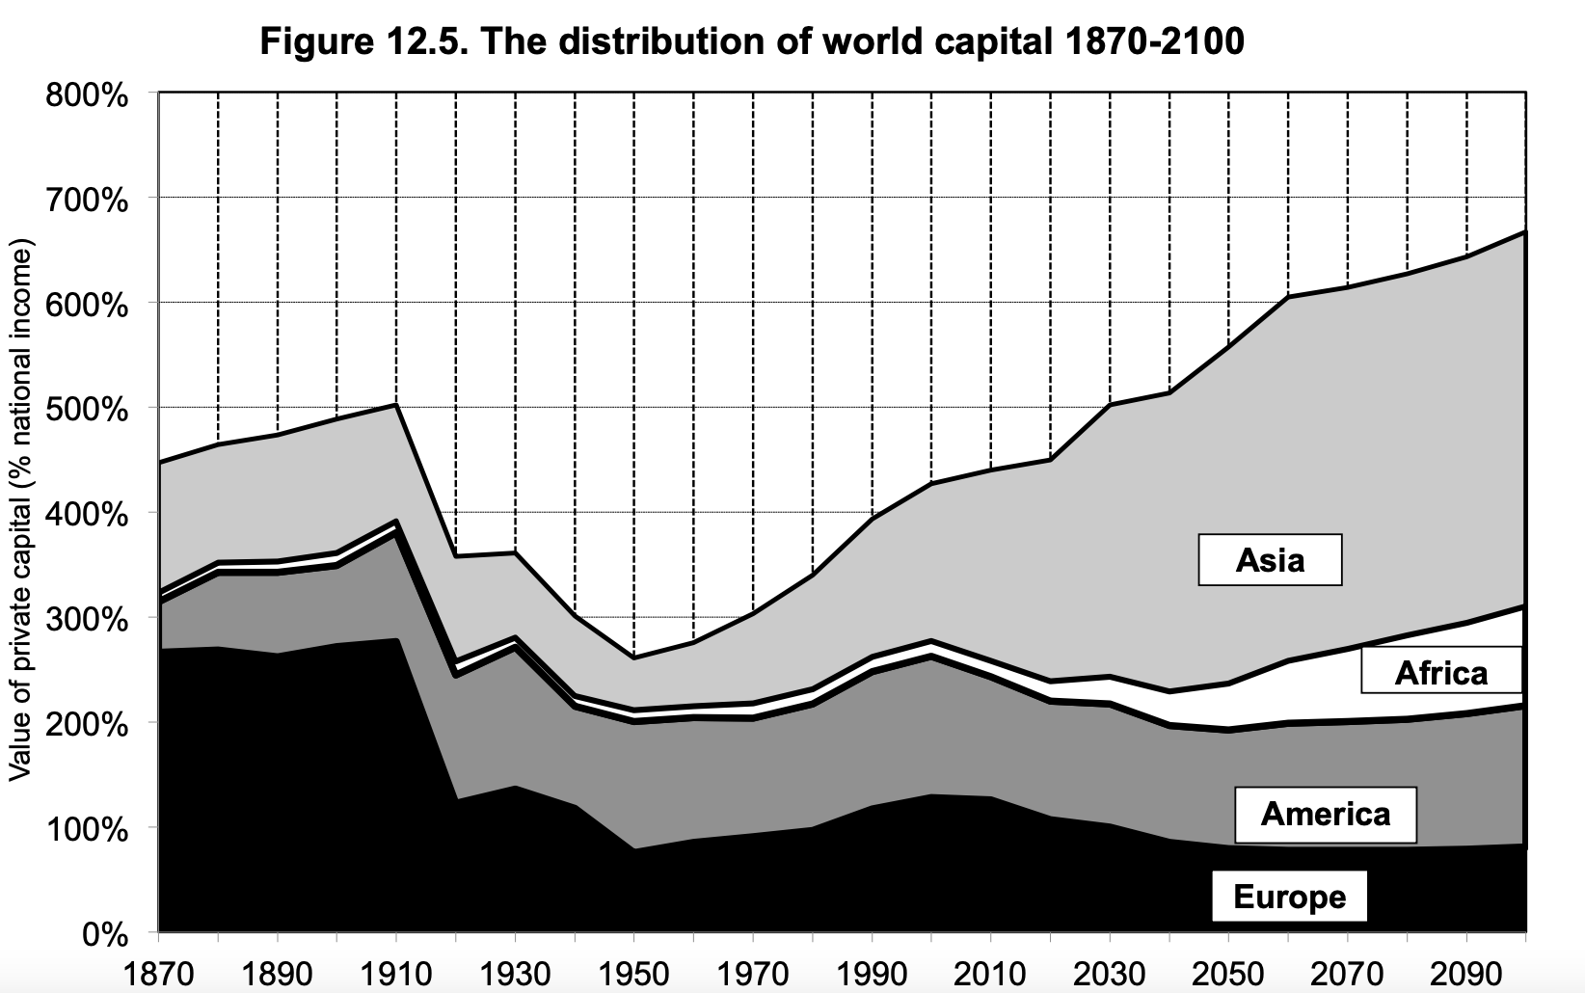
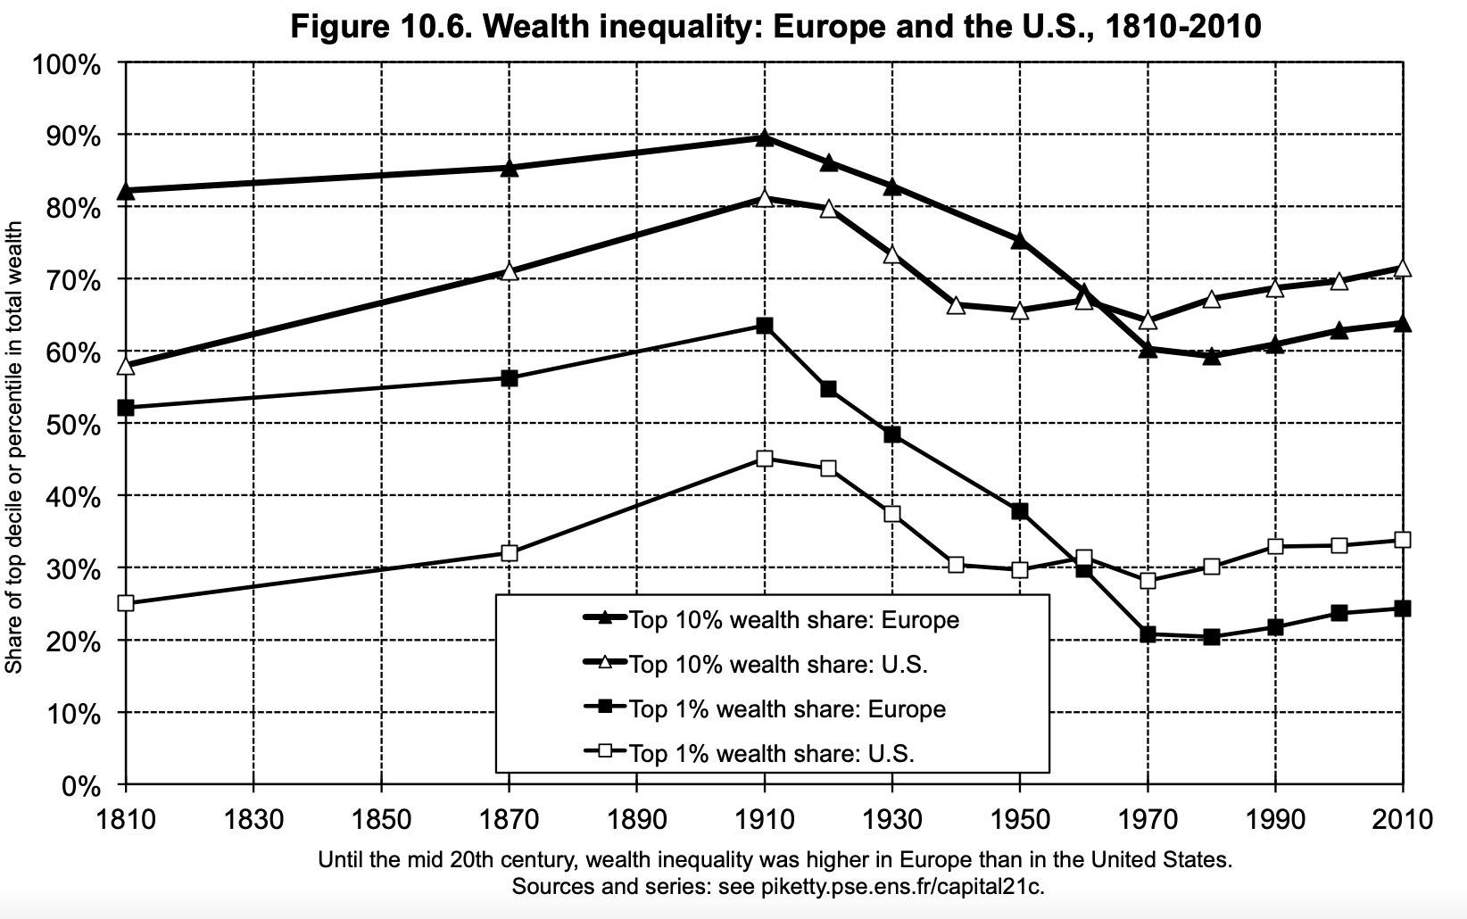
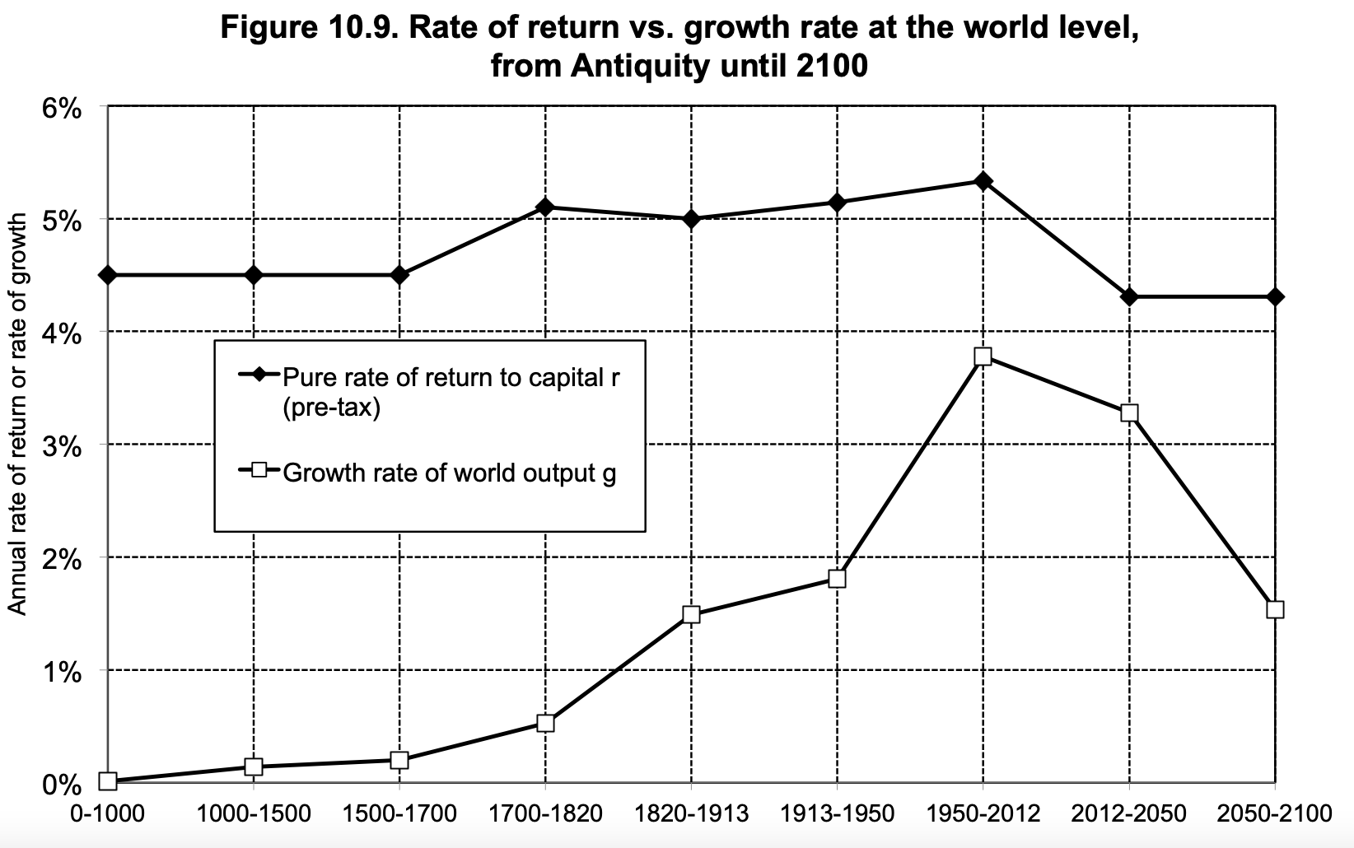
Part I : Inequality in developed countries (2/2)
Wealth inequalities
Asian countries are expected to hold about half of the world's capital in the 21st century.
The richest 1 % drop between 1910 to 1970:
EU: 63% to 20%
US: 45% to 30%
Starting from the mid 20th century, wealth inequality was higher in US than in the EU.
The rate of return to capital (pre-tax) has always been higher than the world growth rate, but the gap was reduced during the 20th century, and might widen again in the 21st century.

Slide 7
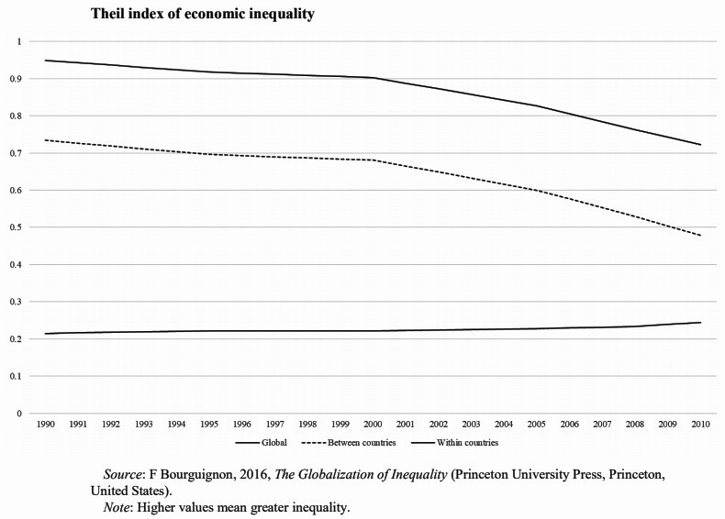
Part I : Impact of International Trade on inequality in developed countries (1/2)
The offshoring model of global production has greatly contributed to the reduction of between-country inequality, creating employment and raising living standards in many developing countries. While in general, in developed countries, offshoring has increased inequality by lowering wages for unskilled labor and blue-collar employment opportunities.¹⁾
Foreign direct investment (FDI) is considered to have influence on income inequality of a country.²⁾ The inclusion of FDI in studies shows that it has a significant effect on income inequality in terms of either GINI index or top 10% income share.³⁾
On one side, the presence of FDI is expected to have influence on government actions.
On the other side, foreign investors leaving the country can result in higher unemployment rate and lower bargaining power of labor union.
Global
Between countries
Within countries
United Nations Conference on Trade and Development, 24-28 June 2019.
The Impact of International Trade on Income Inequality in the United States since 1970’s. By Andoni Fornio Barusman and Yusuf Sulfarano Barusman (2017).
ibid.

Slide 8
Part I : Impact of International Trade on inequality in developed countries (2/2)
Stolper & Samuelson theory : gap between theoretical deduction and reality.
From another perspective, considering what is previously discussed, to what extend the free trade affects the income inequality?
Trade is far from the main driver of observed increases in income inequality in both developed and developing countries.¹⁾ Apart from free trade, government size, the interaction of technology and education, democratization processes and the reshaping of the labor market by unions have played an important role in explaining the dynamics of income inequality in the developed world over the last decades.²⁾
Though the deterioration of domestic income inequality appears in the short term due to free trade, the overall economic growth in the medium and long term will improve the economic conditions of low-income groups, and plus, in the long-term production factors will be re-allocated along with the adjustment of industrial structure, which will weaken negative effects on the less skilled labor.
United Nations Conference on Trade and Development, 24-28 June 2019.
Why is income inequality increasing in the developed world? By Max Roser and Jesus Crespo Cuaresma (2014)

Slide 9
Summary
I
Focus on developing countries
A
Trends of inequalities
B
Impact of International Trade on inequalities

Slide 10
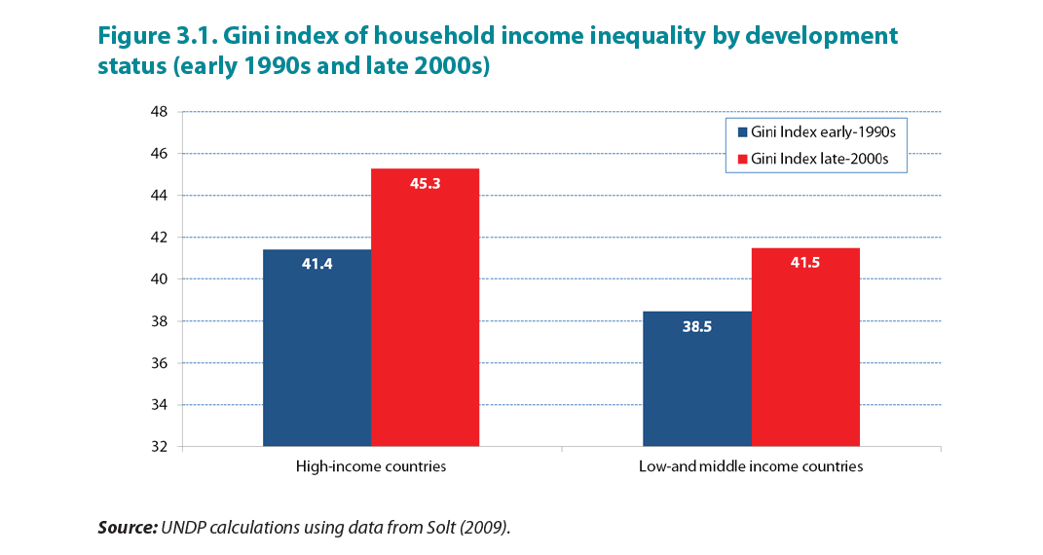
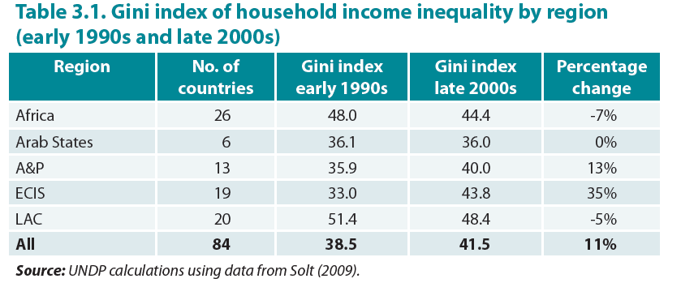
Part II : Income Inequality within Developing Countries (1/3)
Data on Household Income Inequality clearly shows a rising trend within Developing countries between 1990s and the late 2000s.
The population weighted average level of Gini Index increased by 11% for developing countries.
This global overview, however, masks the variation between countries and regions as they experienced increasing and decreasing income inequalities within the same period.
At a regional level, Income Inequality increased on an average in all developing countries except Africa and Latin America.
The largest increase in Income inequality has been in ECIS and Asia Pacific regions with a 35% and 13% rise respectively.
Africa and Latin America have however, experienced a decline in income inequality, mainly owing to Brazil, Argentina and Mexico.
Source: November 2013, HumanityDivided_Full-Report.pdf, United Nations Development Program

Slide 11
Part II : Income Inequality within Developing Countries (2/3)
At a Global level, most developing countries have experienced growth since the past two decades but faster growth has also reflected a more acute increase in income inequality.
However, rising inequality is not an inevitable consequence of growth because some countries like Brazil were able to reverse this trend despite continued growth.
Thus, it is important to understand the exogenous or global drivers and endogenous drivers (influenced by national policies) of Income Inequality.
Factors affecting Household Income Distribution : The distribution of Labor endowments, the distribution of capital endowments, and the way in which aggregate output is distributed between the two affects the household income distribution. It has been noted that the distribution of capital is more unequal than that of labor and an increase in labor share of total income would lead to a decrease in income inequality. A larger labor share is associated with a lower Gini Index of personal incomes.
Source: November 2013, HumanityDivided_Full-Report.pdf, United Nations Development Program

Slide 12
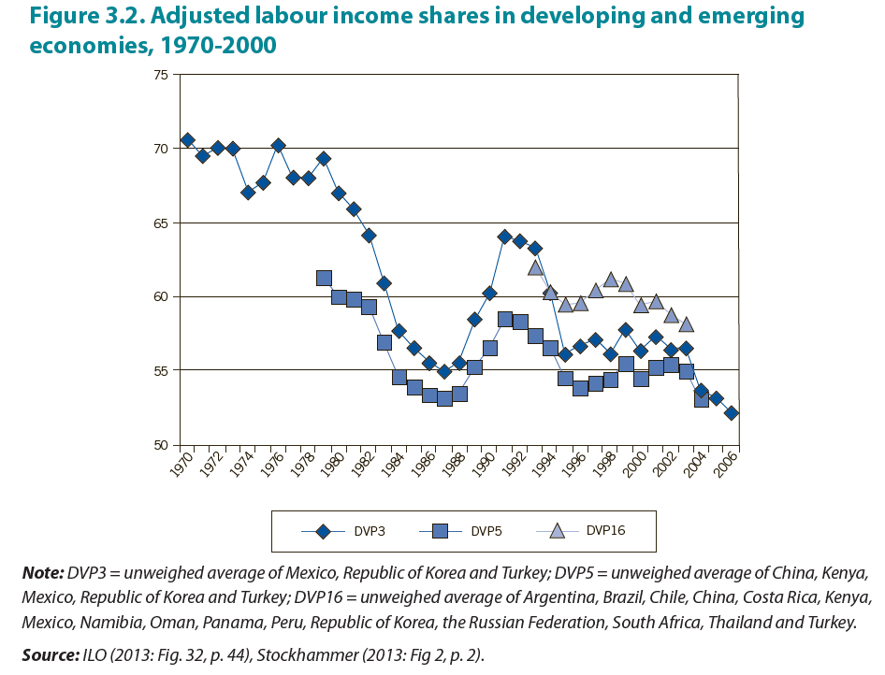
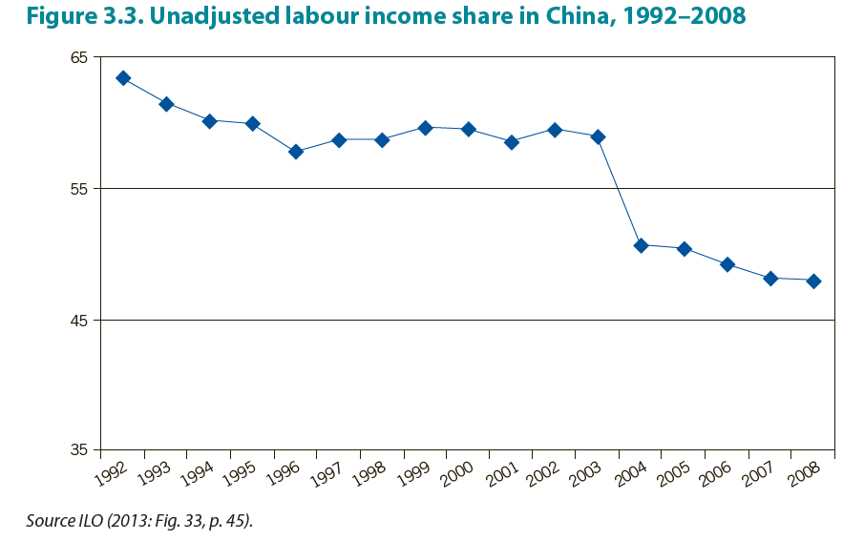
Part II : Income Inequality within Developing Countries (3/3)
Functional Distribution of Income:
Over the years, labor has been losing ground to capital in the share of total income. (as is evident from figure 3.2) It is important to understand how incomes are generated in the production process and how this affects the functional inequality.
It is also noted that profits have been rising much faster than the wages that conflicts the widely held view of social justice and fairness. The share of labor in total GDP has declined over the years.
The decline in labor shares is not limited to a particular sector but an economy wide phenomenon. The downward trend in wage share of value added is more pronounced in developing countries, mainly Asia and North Africa.
The average of labour shares in a group of 16 developing and emerging economies declined from around 62 percent of GDP in the early 1990s to 58 percent by 2008 (Figure 3.2). Even in China, a country where wages roughly tripled between 1990s and 2000s, GDP increased at a faster rate than the total wage bill—and hence the labour income share went down (Figure 3.3).
The exogenous and endogenous drivers (addressed further in the presentation) have an impact on the functional distribution of income that further impacts income inequality within countries.
Source: November 2013, HumanityDivided_Full-Report.pdf, United Nations Development Program

Slide 13
Part II : Impact of Trade on Inequality in Developing Countries (1/2)
Heckscher-Ohlin model ¹⁾
Countries export goods that use intensively the factor they abundantly possess
Internal inequalities should have diminish in developing countries due to the creation of numerous jobs.
Yet, the data invalidate the theory : countries such as Latin America and Sub-Saharan Africa have experienced the destruction of high productivity jobs in manufacturing and the creation of lower-productivity jobs, or even the development of informal services.²⁾
November 2013, HumanityDivided_Full-Report.pdf, United Nations Development Program
McMillan and Rodrik, 2011
Source:

Slide 14
Part II : Impact of Trade on Inequality in Developing Countries (2/2)
Financial globalization ¹⁾
Financialization has been damaging for developing countries because of :
Rising real exchange rates (usually leading to an increase in imports, reducing the absorption of unskilled labour, increasing informalization and wage inequality),
Financial volatility (international capital flows vary a lot according to “manics” and “panics” of financial markets),
The lack of compensating national measures.
A telling example is the period of the Washington Consensus in the 1980s, after the debt crisis, that aimed at imposing many policies to countries in need of international capital (such as Argentina). The consequences were disastrous and led to a drastic increase in internal inequalities.
November 2013, HumanityDivided_Full-Report.pdf, United Nations Development Program
Source:

Slide 15
Summary
1
Introduction
2
I. Developed countries
3
II. Developing countries
4
Conclusion

Slide 16
Conclusion
Trade can benefit global economy, while within a country, the gains / losses may vary among different labor groups.
When we talk about global trade, factors such as offshore production, FDI, labor & capital distribution indeed affect income inequality. Yet apart from trade, other elements exist, including policies, technology, education etc., which also explain the income gap.
Since all the factors are variable in the long run, the negative influence in the short term might be mitigated as well.
“For or against global trade” has always been a debatable topic, and it is likely to remain so.

